Slide 1
Writing an Introduction
OUR FORMULA…
Begin with a broad statement about your topic.
Focus on the purpose of the essay – what are you going to prove?
Briefly discuss your arguments in the order you will write about them in the body.
Use a connecting sentence to launch into your body – your first argument.

Slide 2
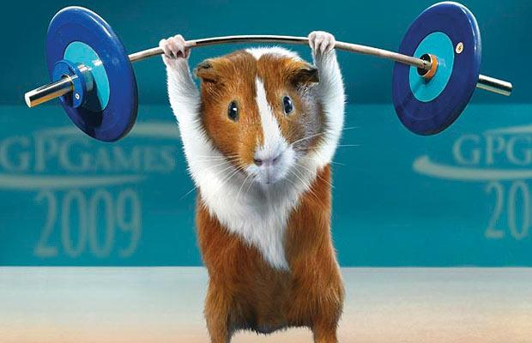
Writing an Introduction
OUR GUINEA PIG…
Shaikha needs your help! She has to write an essay on the quality of Justin Beiber’s music for Mr James and it is due tomorrow.
After much research into the topic, she has concluded that Justin Beiber’s music is of extremely high quality.
She knows this because of his extremely high record sales and because he was noticed, among millions of ‘wannabes’, by the very talented and very famous Usher.
HELP HER WRITE HER INTRODUCTION...

Slide 3
1. Begin with a broad
statement about your topic…
Introduce me to the reader. Tell them a little about me...

Slide 4
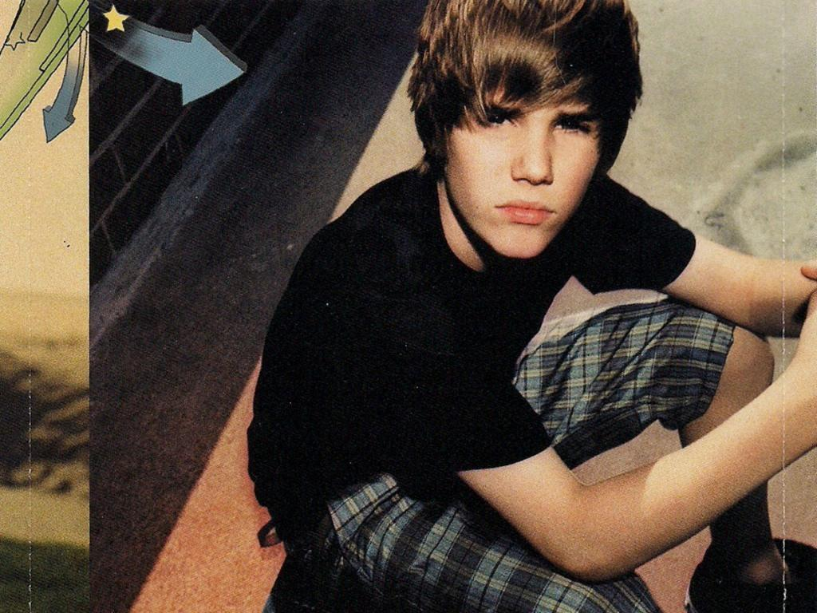
2. Focus on the purpose of the essay…
My Music is so good!
Mum!!!!!!!!!

Slide 5
3. Briefly discuss your arguments
in the order you will write
about them in your essay…
Get me out of here!
Justin, your music is so good because...
I also think your music is like soooo good because...

Slide 6
4. Use a connecting sentence
to launch into your body –
this will be your first argument…
What was that first thing you said Shaikha???

Slide 7
Put it all together and what do
you get???
A well written introduction on why this guy’s music is so good...

