Slide 1
TODAY :
Triangles
-Triangle notes
-classifying triangle worksheet
-Additional polygon worksheets

Slide 2
Classifying Triangles
According to the Length
Of their Sides
3 Types of Triangles

Slide 3
What is a Triangle:
the word triangle means
three (tri) angles.
every triangle has three
angles and three sides.
the sum of all angles in
a triangle equals 180º.
markings on a triangle will indicate
if the triangles sides are equal in length
interior markings of a triangle will
indicate if the triangle angles are equal in size

Slide 4
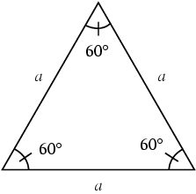
1. Equilateral Triangles
- all three sides are equal in length.
all three angles are equal in size
all angles are 60º

Slide 5
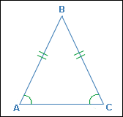
2. Isosceles Triangles
two sides that have same length
two angles that are equal
The side that is not the same length is the base.

Slide 6
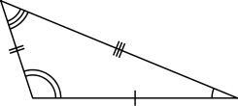
3. Scalene Triangle
three sides of different length
three different angles

Slide 7
6 Names of Triangle Angles:
Right Angle
Acute Angle
Obtuse Angle
Reflex Angle
Straight Angle
Revolution Angle

Slide 8
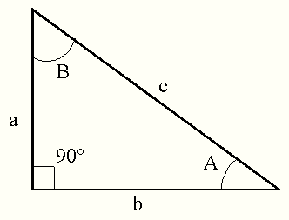
1.Right Angle Triangle
a right angle triangle has one of its angles equal to 90º (one of its angles is a right angle).
Some scalene triangles are also right angle triangles
look for a box in a corner of a triangle = 90º

Slide 9
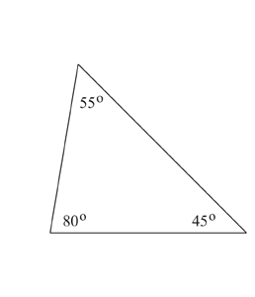
2.Acute Angle Triangle
all angles are smaller than 90º.
all three angles are acute.

Slide 10
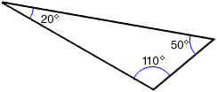
3. Obtuse Angle Triangle
angles that are between 90º - 180º.
that is, one angle is obtuse.

Slide 11
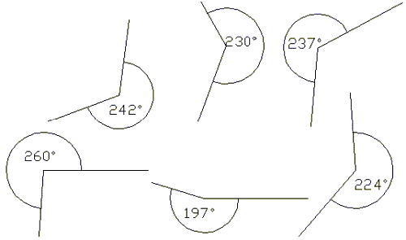
4. Reflex Angle Triangle
an angle that is between 180º and 360º

Slide 12
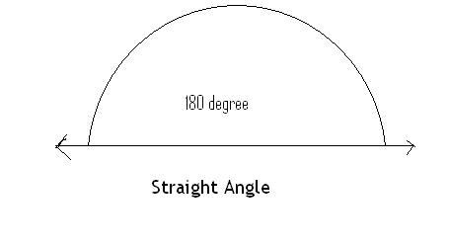
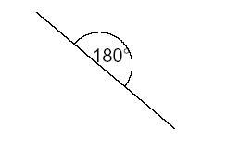
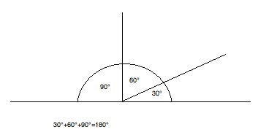
5. Straight Line or Angle
a straight line has an angle of 180º

Slide 13
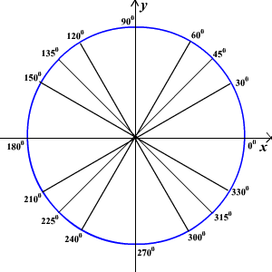
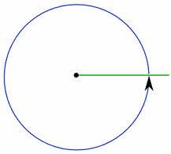
6. Revolution Angle (perigon)
An angle that has completed one full revolution (or circle)
An angle that has achieved 360º

Slide 14
Homework:
Complete classifying triangles worksheet
Use ruler to draw triangles

