Slide 1
RaTEs, RATIO & propORTION
NUMBERS UNIT:

Slide 2
RATIO:
A ratio is used to compare numbers or quantities – a comparison between two things
Ratios are expressed in words "the ratio of something to something else."
Ratios can be written in several different ways:
as a fraction; 3/4
using the word "to“; “3 to 4 “
or with a colon; 3 : 4

Slide 3
Ratio Examples:
Can you think of any examples where you use ratio?

Slide 4
Ratio Examples:
Eg. In my hand I have a glass of fruit juice. It is one part fruit and four parts water.
How many parts are there all together? ____________
How many parts are fruit? _____________
How many parts are water?_____________
In 3 different ways, write the ratio for the glass of fruit juice.
a. b. c.

Slide 5
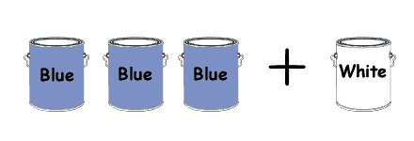
Ratio is also the number of parts to a mix.
The paint mix has how many parts? ________
How many parts are blue? _______
How many parts are white? _________
The order in which a ratio is stated is important. We start from left to right.
Mixing paint in the ratio ____:_____
(3 parts blue paint to 1 part white paint) means 3 + 1 = 4 parts in all.
Write the ratio of the paint as a fraction.
¾ blue paint to ¼ white paint.

Slide 6
COMPLETE THE FOLLOWING AS RATIOS:
Use a fraction, colon and “to” when writing out each ratio.
Six parts fruit to 2 parts milk
Sixteen boys to thirteen girls
Nine kilograms to twelve kilograms
Four seconds to one minute
Four hundred meters to one kilometer
Sixteen cm to one meter
Forty ml to one litre
Four parts black paint to seven parts red paint
6:2 6/2 6 to 2
16:13 16/13 16 to 13
9kg:12kg 9kg/12kg 9kg to 12kg
4s:60s 4s/60 s 4s to 60s
400m:1000m
16cm:100m
40ml:1000ml
4:7

Slide 7
Simplifying Ratios:
Ratios can sometimes be simplified.
15:30 = 3:6
Can you think of another simplified ratio from the above question?
12:24 = 6:12
Hint: If having trouble, think of a ratio as a fraction, then simplify.

Slide 8
HOMEWORK:
Complete Ratio worksheet

