Slide 1
Quadrilaterals

Slide 2
What are quadrilaterals?
A two dimensional closed shape with four straight sides is called a quadrilateral.
Quad means four.
Quadrilaterals can be classified as follows:
1. Parallelograms
2. Rectangles
3. Rhombus
4. Squares
5. Trapeziums
6. Kites
7. Irregular Quadrilaterals

Slide 3
1. Parallelograms
opposite sides are of equal length (AB=DC; AD=____).
opposite sides are parallel (AD//BC; DC // ____)
opposite angles are equal in size (<A=<C; <D=<____).

Slide 4
2. Rectangle
opposite sides are of equal length.
all angles are the same and equal to 90º (right angle triangle).
opposite sides are parallel
diagonals are equal

Slide 5
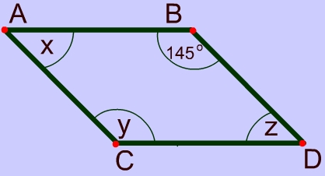
3. Rhombus
differs from a parallelogram because all sides are equal in length.
opposite angles are equal in size.
diagonals bisect each other and form a right angle (90⁰)

Slide 6
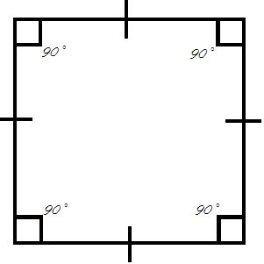
4. Square
all sides are of equal length.
all angles are the same size =90º .

Slide 7
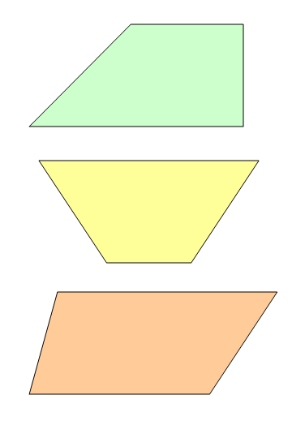
5. Trapezium
A B
- one pair of opposite sides are parallel (AB//CD).
C D

Slide 8
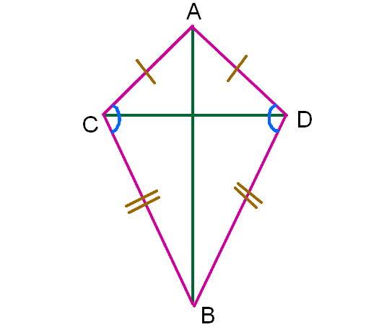
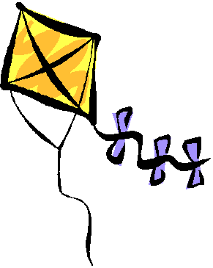
6. Kite
two pairs of sides next to each other are equal in length.
one pair of opposite angles are equal in size.
diagonals are perpendicular

Slide 9
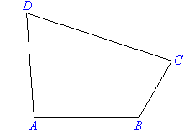
7. Irregular Quadrilateral
- this shape has no special properties.

Slide 10
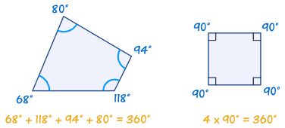
Angles in a
quadrilateral
-the sum of all angles in a quadrilateral equal 360º.
-we can use this information to find the size of missing angles.

Slide 11
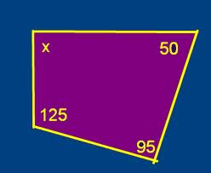
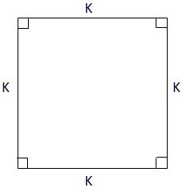
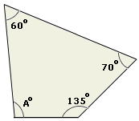
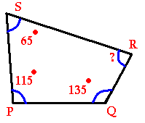
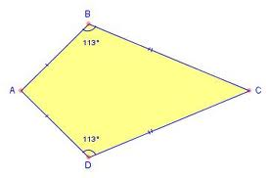
Find the missing angles…
2.
3.
1.
4.
5.

Slide 12
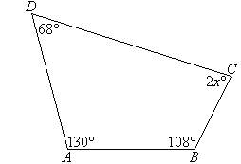
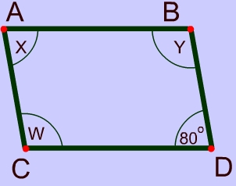
Find the missing angles…
6.
7.
8.
9.

Slide 13
Draw the following…
FOR EACH OF THE FOLLOWING, DRAW THE SHAPE & LABEL THE SIZE OF EACH ANGLE:
This shape has four equal sides.
This shape has four sides. Two of these sides are parallel and the same length. The other two sides are also parallel and of the same length. One of the angles is 53º.
This shape has four sides. Two sides are the same length as one another. The other two sides are the same length as one another. One of the angles is 90º.
This shape has four equal sides. One of the angles is 60º. Another is 120º.
This shape has two lines next to each other of equal length. The other two lines are also of equal length to one another. One pair of opposite angles are equal. One of these angles equals 42º.

