Slide 1
Friction
Friction is the force applied to the surface of an object when it moves against the surface of another object.
Friction limits how fast you can go.
Rough surfaces produce more friction than smooth ones.

Slide 2
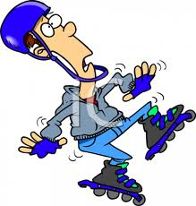
Consider this…
To slow down quickly on rollerblades you need to use a stopper so that there is more friction.
If there was no friction then your feet would slip backwards and you would probably fall over.
However too much friction, and it would take too much effort to keep moving.

Slide 3
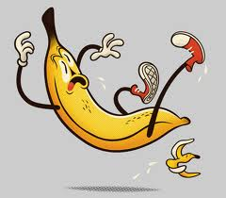
Ever slipped on a banana peel?
Walking requires friction. When you walk, you push your foot backwards against the ground so that the ground pushes you forward.
Without friction your foot would slip backwards as it does on a banana peel.
Even holding objects in your hand requires friction… SOAP!!!

Slide 4
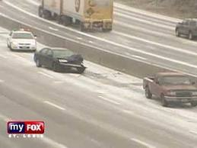
What about cars???
Cars also rely on friction to turn, move and stop.
The friction created between break pads and the wheels forces a a car to come to a sudden stop, should it need to.
The lack of friction between car tires and icy or wet roads spells disaster in car accidents.
It takes longer for a car to gain traction or friction with the road, and the car can sometimes slide.
http://www.youtube.com/watch?v=-diu2KDn7d4

Slide 5
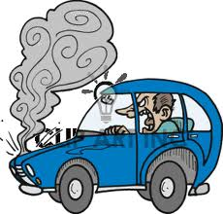
Hot machines…
Those big machines that work hard to construct our megastructures, or run our megastructures, count on friction to make things happen.
Despite this, when metal continually rubs against metal, the friction creates heat.
This is part of the reason a car’s engine gets so hot. If the car’s cooling system cannot work effectively, the car overheats! RUB YOUR HANDS…

Slide 6
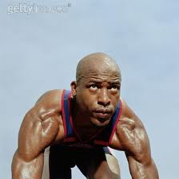
Smooth Running…
Objects travel faster if they are smooth.
Skis and surfboards are waxed and buffed to reduce friction and make them go faster through snow or water.
WHY DO SOME ATHLETES SHAVE THEIR LEGS, HEAD ETC???

Slide 7
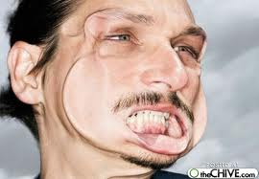
Fluid Friction
Any shape that is able to take up the shape of its container and can flow is called a fluid.
Air and water are both fluids, and objects traveling through air and water experience fluid friction.
Fluid friction acts against the the motion of objects and increases the amount of fuel needed by planes, cars etc.

Slide 8
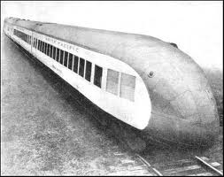
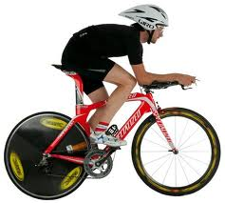
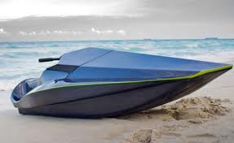
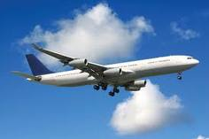
Streamlining…
Streamlining is designed on cars, planes, watercrafts and bicycles to reduce fluid friction.
The faster an object needs to travel, the more important streamlining becomes.

Slide 9
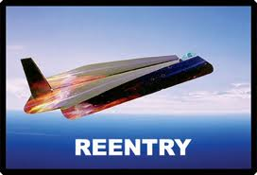
Case Study…
One of the most dangerous stages of a space shuttle mission is the re-entry into the Earth’s atmosphere. After travelling through space with almost no friction at all, the shuttle fires it engines to slow down.
It enters the atmosphere at a speed of about 26,000km/h. Because it is travelling so fast, the force of fluid friction is large enough to slow it down to about 2000km/h within minutes.
The temperature on the surface of the wings reaches 1500°C. Over 25,000 ceramic tiles on the surface of the shuttle prevent it from burning up. They protect the astronauts inside from the incredible heat.
As it slows down, the size of the force of fluid friction on the shuttle decreases and it gradually cools down. It zig-zags through the lower part of the atmosphere, cooling down and getting into the correct landing path. About one hour after leaving its orbit, the shuttle lands at a speed of about 300km/h.

