Slide 1
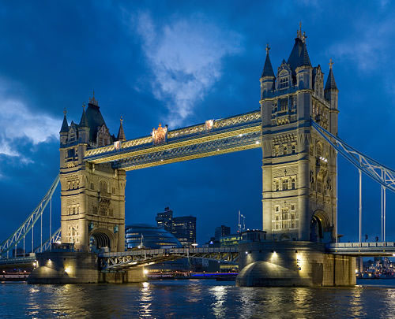
MEGA STRUCTURES BRIDGES

Slide 2
RECAP OF WHAT WE LEARNED SO FAR:
TYPES OF FORCES
i) Contact Forces
ii) Non-Contact Forces
SIMPLE MACHINES
i) Levers
ii) Pulleys
iii) Gears
BRIDGES (NEW)
i) Beam bridges
ii) Truss bridges
iii) Arch bridges
iv) Suspension bridge
ENVIRONMENTAL ISSUES (positive and negative impacts-essay)

Slide 3
BACKGROUND ABOUT BRIDGES:
There are more than half a million bridges in the United States, and you rely on them every day to cross obstacles like streams, valleys, and railroad tracks. But do you know how they work? Or why some bridges are curved while others are straight?
Engineers must consider many things -- like the distance to be spanned and the types of materials available -- before determining the size, shape, and overall look of a bridge.
Since ancient times, engineers have designed three major types of bridges to withstand all forces of nature.

Slide 4
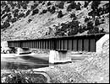
BEAM BRIDGE
Consists of a horizontal beam supported at each end by piers.
The weight of the beam pushes straight down on the piers.
The farther apart its piers, the weaker the beam becomes. This is why beam bridges rarely span more than 250 feet.

Slide 5
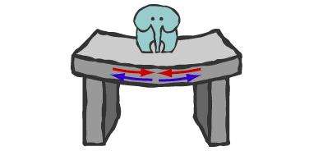
Beam Bridge: Forces
When something pushes down on the beam, the beam bends. Its top edge is pushed together, and its bottom edge is pulled apart

Slide 6
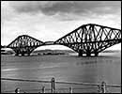
TRUSS BRIDGE:
Consists of an assembly of triangles.
Truss bridges are commonly made from a series of straight, steel bars.
The Firth of Forth Bridge in Scotland is a cantilever bridge, a complex version of the truss bridge. Rigid arms extend from both sides of two piers. Diagonal steel tubes, projecting from the top and bottom of each pier, hold the arms in place. The arms that project toward the middle are only supported on one side, like really strong diving boards. These "diving boards," called cantilever arms, support a third, central span

Slide 7
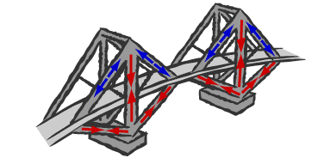
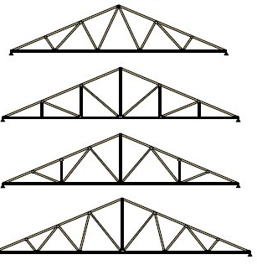
TRUSS BRIDGE: FORCES
Every bar in this cantilever bridge experiences either a pushing or pulling force.
The bars rarely bend. This is why cantilever bridges can span farther than beam bridges.

Slide 8
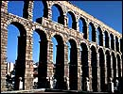
ARCH BRIDGES:
Great natural strength.
Thousands of years ago, Romans built arches out of stone.
Today, most arch bridges are made of steel or concrete, and they can span up to 800 feet

Slide 9
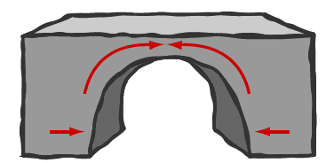
ARCH BRIDGE: FORCES
The arch is squeezed together, and this squeezing force is carried outward along the curve to the supports at each end.
The supports, called abutments, push back on the arch and prevent the ends of the arch from spreading apart

Slide 10
SUSPENSION BRIDGE:
Can span 2,000 to 7,000 feet -- way farther than any other type of bridge!
Most suspension bridges have a truss system beneath the roadway to resist bending and twisting

Slide 11
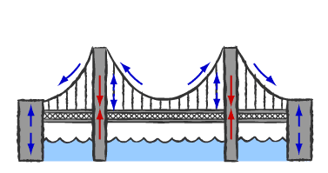
SUSPENSION BRIDGE: FORCES
In all suspension bridges, the roadway hangs from massive steel cables, which are draped over two towers and secured into solid concrete blocks, called anchorages, on both ends of the bridge.
The cars push down on the roadway, but because the roadway is suspended, the cables transfer the load into compression in the two towers. The two towers support most of the bridge's weight

